Slide 1

Fusion Tables
Jeff Terrell
ECEN 489-501 Spring 2014

Slide 2

What is a Fusion Table?
Google Fusion Tables is a web application used for sharing, visualizing, and publishing tabular data
Ways to import data into a Fusion Table
.CSV (comma separated value)
.KML (keyhole markup language)
.ODS (operational data store)
.XLS (Microsoft Excel spreadsheet)
Google Spreadsheet data
So what now? Lots of things.
Real-time collaboration
Google search publishing
Map and chart visualizations
Filtering
Update data behind filters and visualizations real-time

Slide 3
Google Plugin and Fusion Tables API
The Google plugin for Eclipse allows Google APIs to be imported into projects. This is a requirement for development using any Google API. Installation and repository information can be found here.
So what can I do with the API?
Create and delete tables
Read and modify table metadata such as table and column names and column types
Insert, update, and delete rows in a table
Create, update, and delete settings for certain visualizations
Query the rows in a table
The Fusion Tables API allows developers to implement the core features of Fusion Tables in their program/application.

Slide 4
Important API Elements
Authentication
Creating a Table
Inserting Data into a Table
Deleting a Table
Integration with other APIs

Slide 5
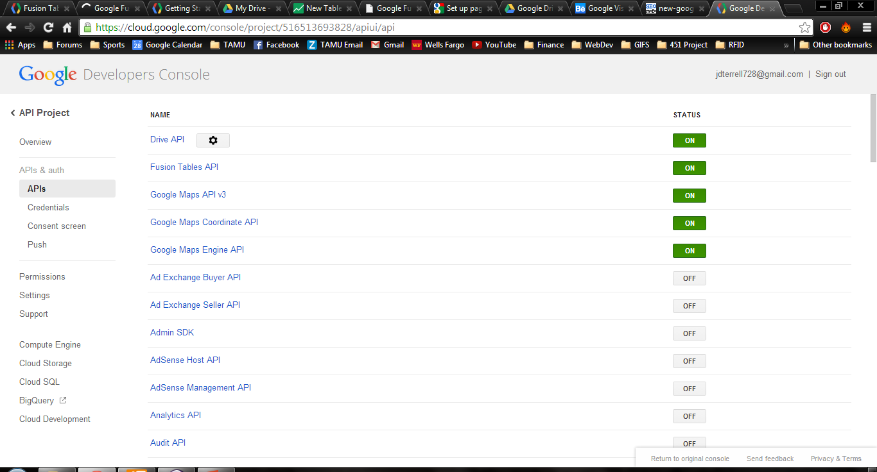
Authentication
Register for Google account
Google Developers Console: https://cloud.google.com/console/project
Create or select a project
Click APIs & auth on left side menu →APIs → set Fusion Tables API and Drive API to
Click Credentials → Create New Client ID → Download the JSON file containing your Client ID and Client secret. This file will be used within your program to authorize your access.

Slide 6
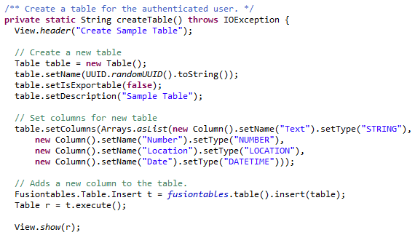
Creating a Table

Slide 7
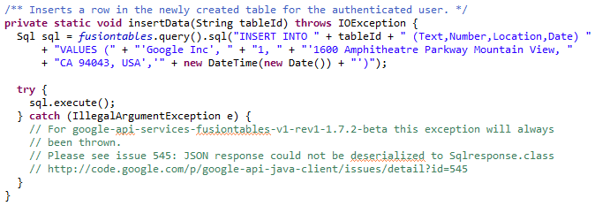
Inserting Data into a Table

Slide 8
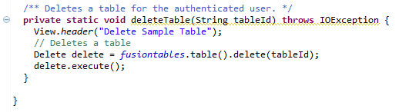
Deleting a Table

Slide 9
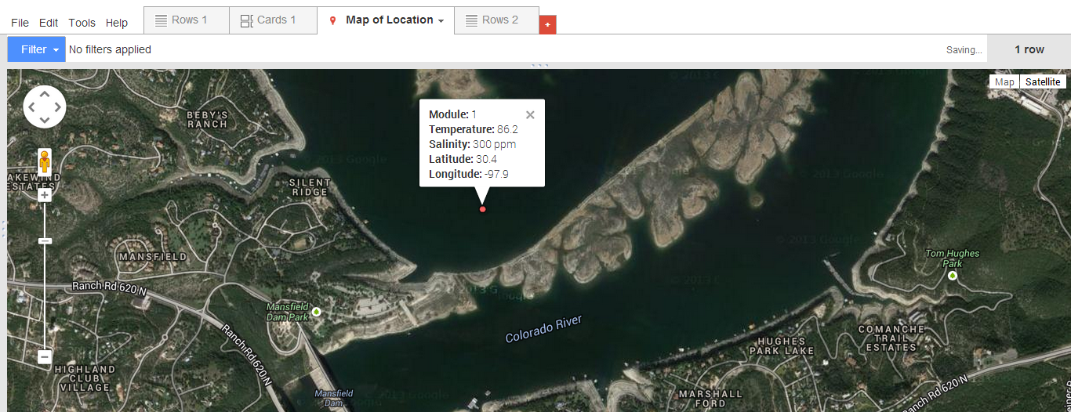
Integration with other APIs

Slide 10
Questions
?

